Slide 1

VX423: Intrapreneurship Spring 2017
Lecture 2: Corporate Entrepreneurship Models

Slide 2
Agenda for March 23
Lecture (10-12PM)
Lunch Break (12-1PM)
Guest Lecture: 1-2PM
Student Cast Study Presentations (2-4PM)

Slide 3
The Need for Corporate Entrepreneuring
Rapid growth in the number of new and sophisticated competitors
Sense of distrust in the traditional methods of corporate management
An exodus of some of the best and brightest people from corporations to become small business entrepreneurs
International competition
Downsizing of major corporations
An overall desire to improve efficiency and productivity

Slide 4
The Nature of Corporate Entrepreneurship
Defining The Concept
  Corporate Entrepreneurship
    Activities that receive organizational sanction and resource commitments for the purpose of innovative results.
      A process whereby an individual or a group of individuals, in association with an existing organization, creates a new organization or instigates renewal or innovation within the organization.
      A process that can facilitate firms’ efforts to innovate constantly and cope effectively with the competitive realities that companies encounter when competing in international markets.

Slide 5
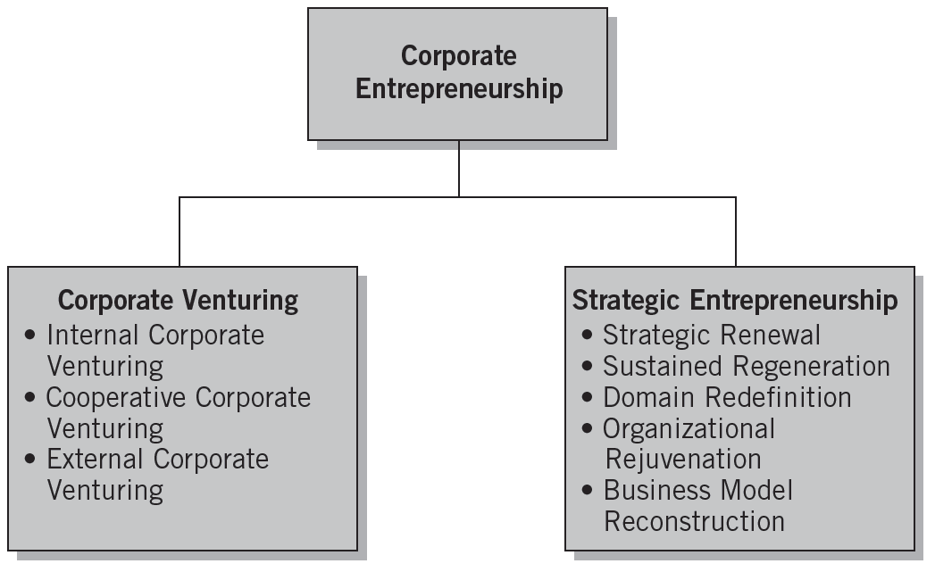
Defining Corporate Entrepreneurship
Source: Michael H. Morris, Donald F. Kuratko, and Jeffrey G. Covin, Corporate Entrepreneurship & Innovation (Mason, OH, Thomson), 2008, p. 81.

Slide 6

^{Table} 3.2 Sources of and Solutions to Obstacles in Corporate Venturing
Traditional Management Practices | Adverse Effects | Recommended Actions
Enforce standard procedures to avoid mistakes | Innovative solutions blocked, funds misspent | Make ground rules specific to each situation
Manage resources for efficiency and ROI | Competitive lead lost, low market penetration | Focus effort on critical issues (e.g., market share)
Control against plan | Facts ignored that should replace assumptions | Change plan to reflect new learning
Plan for the long term | Nonviable goals locked in, high failure costs | Envision a goal, then set interim milestones, reassess after each
Manage functionally | Entrepreneur failure and/or venture failure | Support entrepreneur with managerial and multidiscipline skills
Avoid moves that risk the base business | Missed opportunities | Take small steps, build out from strengths
Protect the base business at all costs | Venturing dumped when base business is threatened | Make venturing mainstream, take affordable risks
Judge new steps from prior experience | Wrong decisions about competition and markets | Use learning strategies, test assumptions
Compensate uniformly | Low motivation and inefficient operations | Balance risk and reward, employ special compensation
Promote compatible individuals | Loss of innovators | Accommodate “boat rockers” and “doers”
Source: “Corporate Venturing Obstacles: Sources and Solutions,” by Hollister B. Sykes and Zenas Block, Journal of Business Venturing (winter 1989): 161

Slide 7
Successful Innovative Companies
Factors in large corporations that are successful innovators:
  Atmosphere and vision
  Orientation to the market
  Small, flat organizations
  Multiple approaches
  Interactive learning
  Skunkworks

Slide 8
Conceptualizing Corporate Entrepreneurship Strategy
Corporate Entrepreneurship Strategy
  A vision-directed, organization-wide reliance on entrepreneurial behavior that purposefully and continuously rejuvenates the organization and shapes the scope of its operations through the recognition and exploitation of entrepreneurial opportunity.
  It requires the creation of congruence between the entrepreneurial vision of the organization’s leaders and the entrepreneurial actions of those throughout the organization.

Slide 9



The Corporate Entrepreneurship Process
Strategic
Renewal
Innovation
Corporate Venturing
Corporate Entrepreneurship

Slide 10
Model of the Corporate Entrepreneurship Strategy Process
Corporate entrepreneurship strategy is manifested through the presence of three elements:
  An entrepreneurial strategic vision
  A proentrepreneurship organizational architecture
  Entrepreneurial processes and behavior as exhibited across the organizational hierarchy.

Slide 11
Model of the Corporate Entrepreneurship Strategy Process (cont’d)
Linkages in the model:
  Individual entrepreneurial cognitions of the organization’s members
  External environmental conditions that invite entrepreneurial activity
  Top management’s entrepreneurial strategic vision for the firm
  Organizational architectures that encourage entrepreneurial processes and behavior
  The entrepreneurial processes that are reflected in entrepreneurial behavior
  Organizational outcomes resulting from entrepreneurial actions.

Slide 12
Types of Innovation
Radical Innovation
  The launching of inaugural breakthroughs.
  These innovations take experimentation and determined vision, which are not necessarily managed but must be recognized and nurtured.
Incremental Innovation
  The systematic evolution of a product or service into newer or larger markets.
  Many times the incremental innovation will take over after a radical innovation introduces a breakthrough.

Slide 13
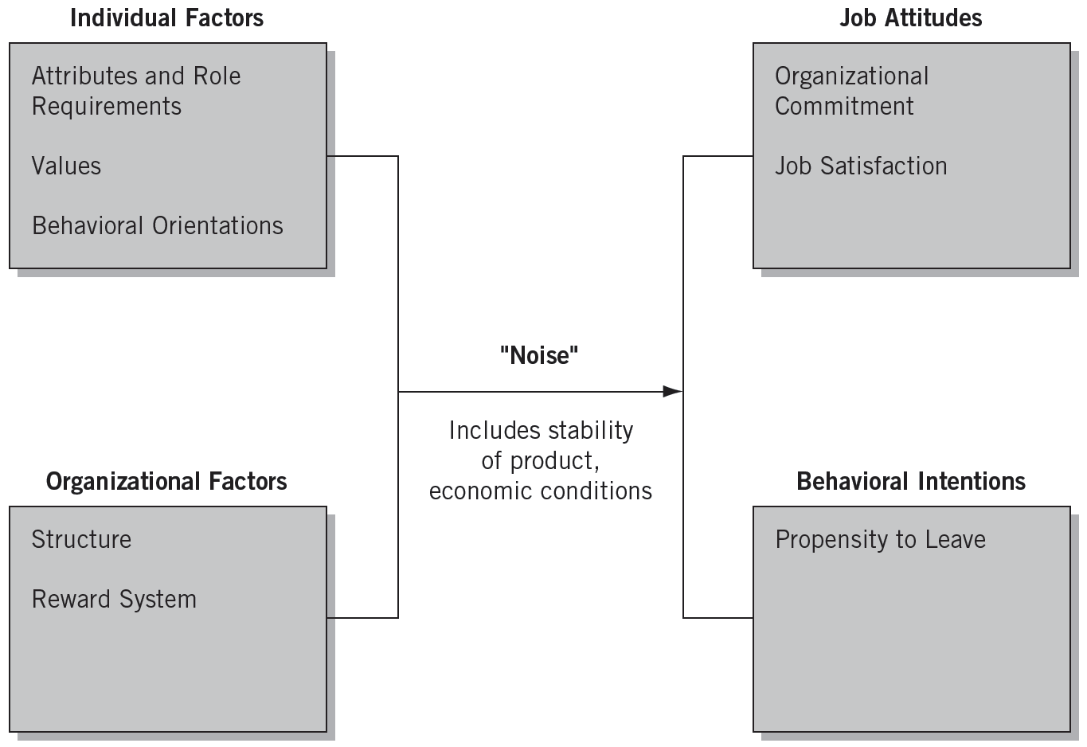
Intrapreneurial Development: Joint Function of Individual and Organizational Factors
Source: Deborah V. Brazeal, “Organizing for Internally Developed Corporate Ventures,” Journal of Business Venturing (January 1993): 80.

Slide 14
Preparing for Failure
“Learning from Failure”
  Recognizing the importance of managing the grief process that occurs from project failure.
  Understanding how organizational routines and rituals are likely to influence the grief recovery.
  Ensuring that the organization’s social support system can encourage greater learning, foster motivational outcomes, and increase coping self-efficacy in affected individuals.

Slide 15
Developing Individual Managers for Corporate Entrepreneurship
Corporate Entrepreneurship Training Program (Corporate Breakthrough Training)
  The Breakthrough Experience
  Breakthrough Thinking
  Idea Acceleration Process
  Barriers and Facilitators to Innovative Thinking
  Sustaining Breakthrough Teams
  The Breakthrough Plan

Slide 16
Factors affecting Entrepreneurial Ventures
The use of teams in strategic decision making
Whether the company is product or service oriented
Whether its innovation efforts are aimed at product or process improvements
The extent to which it is high-tech or low-tech

Slide 17

Focused Approaches to Corporate Entrepreneurship
New venture group
  a group of individuals, or a division within a corporation, that identifies, evaluates, and cultivates venture opportunities.

Slide 18
New Venture Groups
Involvement includes
  Innovation and experimentation
  Coordinating with other corporate divisions
  Identifying potential venture partners
  Gathering resources
  Launching the venture

Slide 19

Focused Approaches to Corporate Entrepreneurship
Business incubator
  supports and nurtures fledgling entrepreneurial ventures until they can thrive on their own as stand-alone businesses.

Slide 20
Business Incubators
Incubators provide some or all of the following functions
  Funding
  Physical space
  Business services
  Mentoring
  Networking

Slide 21
Dispersed Approaches to
Corporate Entrepreneurship
Dedication to principles and practices of entrepreneurship is spread throughout the firm
Ability to change is a core capability
Stakeholders can bring new ideas or venture opportunities to anyone in the organization
Entrepreneurial culture, Product champions
Notes:
Two related aspects of dispersed entrepreneurship
Entrepreneurial culture
Product champions

Slide 22
Product Champions
Product (or project) champions
  Bring entrepreneurial ideas forward
  Identify what kind of market exists for the product or service
  Find resources to support the venture
  Promote the venture concept to upper management
Notes:
New project must pass two critical stages
Project definition
Project impetus

Slide 23
Facilitating Corporate Entrepreneurial Behavior
Organizations foster entrepreneurial behavior by:
  Encouraging—not mandating—innovative activity
  Human resource policies for “selected rotation”
  Committing to projects long enough for momentum to occur.
  Bet on people, not on analysis.
Rewarding Entrepreneuring:
  Allow inventor to take charge of the new venture
  Grant discretionary time to work on future projects
  Make intracapital available for future research ideas

Slide 24
Corporate Innovator’s Commandments
Come to work each day willing to give up your job for the innovation.
Circumvent any bureaucratic orders aimed at stopping your innovation.
Ignore your job description, do any job needed to make your innovation work.
Build a spirited innovation team that has the “fire” to make it happen.
Keep your innovation “underground” until it is prepared for demonstration to the corporate management.
Find a key upper level manager who believes in you and your ideas and will serve as a sponsor to your innovation.
Permission is rarely granted in organizations, thus always seek forgiveness for the “ignorance” of the rules that you will display.
Always be realistic about the ways to achieve the innovation goals.
Share the glory of the accomplishments with everyone on the team.
Convey the innovation’s vision through a strong venture plan.

Slide 25
Developing Innovative (I) Teams
Innovative (I) Team
  A semi-autonomous self-directing, self-managing, high-performing group of two or more people who formally create and share the ownership of a new organization.
  The leader is called a “product champion” or an “corporate entrepreneur.”
Collective Entrepreneurship
  Individual skills are integrated into a group; this collective capacity to innovate becomes something greater than the sum of its parts.

Slide 26
Measuring the Success of Corporate Entrepreneurship Activities
Comparing strategic and financial CE goals
Are the products or services offered by the venture accepted in the marketplace?
Are the contributions of the venture to the corporation’s internal competencies and experience valuable?
Is the venture able to sustain its basis of competitive advantage?

Slide 27
Corporate Entrepreneurship
Assessment Instrument (CEAI)
Key Internal Climate Factors in an Organization’s Readiness for Entrepreneurial Activity
  Management support
  Autonomy/work discretion
  Rewards/reinforcement
  Time availability
  Internal organizational boundaries

Slide 28
Corporate Entrepreneurship at IBM
Emerging Business Opportunity (EBO) Program’s Key Rules:
  Think big . . . really big.
  Bring in the A-team.
  Start small.
  Establish unique measurement techniques.

Slide 29
Summary
Intrapreneurship as a Corporate Entrepreneurship Strategy
A Model for Corporate Entrepreneurship
  Strategic Renewal
  Corporate Venturing
  Innovation
Different Ways of Implementing Corporate Entrepreneurship: Case studies in Discussion

